Slide 1
Effin & Garrienderk Development Association
Parish Projects

Slide 2
Railway Bridges and Linesman Cottage
The Effin Road from Charleville crosses the Cork Dublin railway line. This railway effectively splits Effin from Lower Effin and Garrienderk.
This bridge has some outstanding stonework on both sides which has been covered by years of overgrowth . It would be great to expose the workmanship as a heritage project.
On the North side of the rail track is an old Irish Rail linesman cottage.This served as a manual point change for the now disused Limerick line . The structure is still there but would need a re-roof. Ownership of the building is unclear. This cottage , and its surrounding land could be a point of interest for the proposed Green way for the disused Limerick rail line.

Slide 3
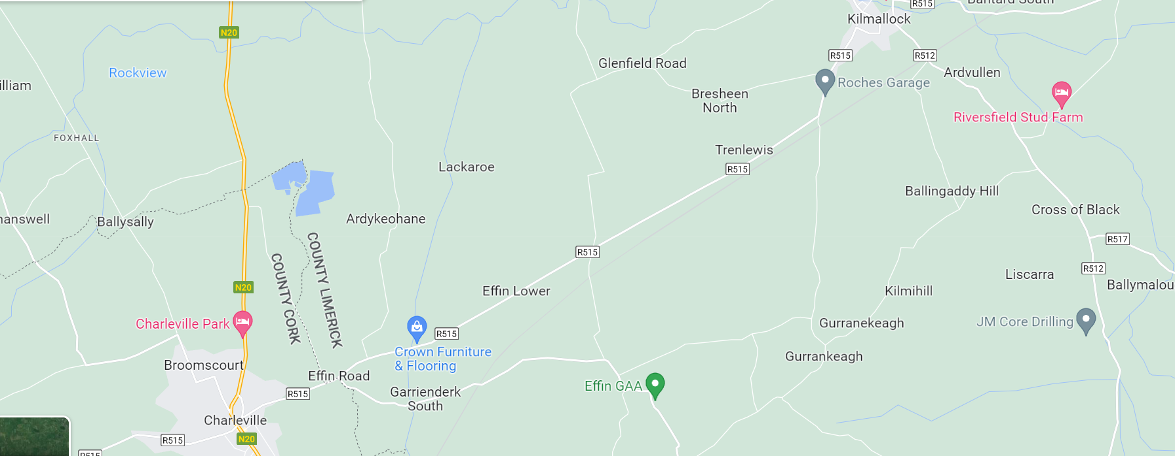
MAPS

Slide 4
MAPS

Slide 5
Update/Refurbish the Info Signs at the Church Also info signs at Effin and Kilquane Graveyards

Slide 6
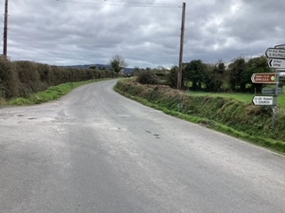
Footpath Necessities
The road from Effin Cross to the Sportsfield and onto the school is long overdue a footpath to connect up our School to the GAA, Parish Hall-Cemetary and Church.

Slide 7
Routing of Footpaths to be agreed with Limerick Co Co Civil Engineer.

Slide 8
Footpath Necessities
Footpaths from the church to the hurling field.
Footpath from the Hurling field to the School
Footpaths or hard margins between the two "Effin signs where the wheelbarrows are.
Fill in the dyke between Effin cross and Riordan Cross

Slide 9
Update the Effin Parish signs to match the Garrienderk Sign

Slide 10
Canon Hayes Hall
Sensory Garden
Resurface Car Park
Power Hose Side of Hall

Slide 11
Effin Creamery
Information Sign with history of Creamery

Slide 12
Religious Sites
Clean up and conserve Kilbreedy Graveyard. - now overgrown. Footpath also required for safe access up a grassy incline. Also safe parking space at the road side
Improve the ancient path up to Holy Well 'Tobar Rí a Domhnaigh’,
Rebuild the stone around the Holy Well with a sign explaining the history of the well.
Signs and storyboards at Graveyards /Churches

Slide 13
Heritage Stone Wall Another example of a stone wall by the Idle Hour Pub which, If exposed , would be a nice landmark with a thatched cottage nearby

Slide 14
Waste Recycling Facility
There is no Glass ReCycling or Clothes Bank in Effin like the facility in Ardpatrick

